Slide 1
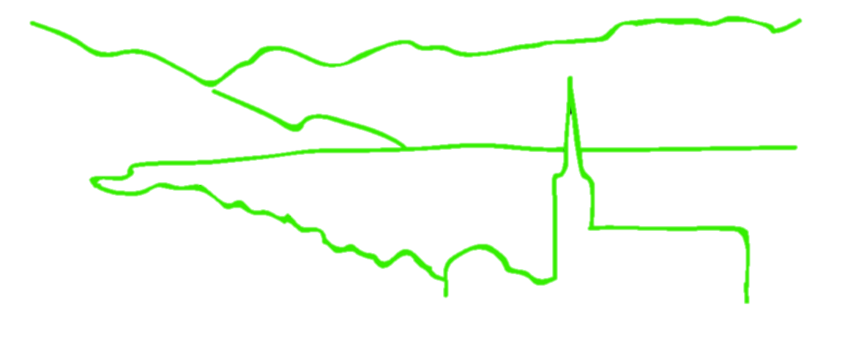
RADseq Pipelines: an overview
B @ G⁴
i
o
i
n
for
o
r
m
a
t
i
c
s
d
a
p
t
a
t
i
o
n
e
n
o
m
i
c
s
Jonathan B. Puritz
University of Rhode Island

Slide 2

Class Survey
Pipeline | dDocent | Stacks | pyRAD | aftrRAD | Other
Participants Familiar with pipleine | 0 | 8 | 0 | 0 | 2
2015
Pipeline | dDocent | Stacks | pyRAD | aftrRAD | Other
Participants Familiar with pipleine | 5 | 22 | 11 | 1 | 7
2016
Pipeline | dDocent | Stacks | pyRAD | aftrRAD | Other
Participants Familiar with pipleine | 7 | 20 | 13 | 0 | 0
2017
Pipeline | dDocent | Stacks | pyRAD | aftrRAD | Other
Participants Familiar with pipleine | 8 | 16 | 10 | 0 | 2
2018
B@G 2018

Slide 3
The pipelines
Stacks (Catchen et al. 2013)
The first mainstream RADseq software
Designed specifically for mbRAd but can handle ddRAD
dDocent (Puritz et al. 2014)
Simple customizable backbone for bioinformatics
Designed specifically for ddRAD and ezRAD
pyRAD (Eaton 2014)
Analysis pipeline written in python
Can handle many RADseq types, focused on phylogentics
aftrRAD (Sovic et al. 2015)
Newest kid on the blog
Offers a blend between Stacks and pyRAD
B@G 2018

Slide 4
Stacks
Advantages
Disadvantages
By far the most developed software option.
Syncs with a MySQL database
Can handle reference based analysis or de novo assembly
Can output multiple formats
The de novo assembly method cannot handle INDEL variation at all.
Reads with INDELs will not cluster together
Reads must remain a fixed length, so low quality reads are removed instead of trimmed
Does not call SNPs in PE reads
Has a single sample, single base pair model for SNP calling
rxstacks does improved SNP calls
B@G 2018

Slide 5
dDocent
Advantages
Disadvantages
Performs read trimming and is INDEL aware for assembly and read mapping
Follows a stepwise, traditional NGS workflow
Has a novel data reduction method for de novo assembly
Open source BASH code that is easy to customize
Currently the final output is limited to VCF files.
Requires several different software dependencies and can be difficult to install.
Limited by the development of dependent packages
B@G 2018

Slide 6
pyRAD
Advantages
Disadvantages
Flexible package designed to handle multiple different RADseq methods
Open source, easy to read python code
Performs clustering and alignment, so INDELS are properly handled
Can output several different output types directly
Cannot handle a reference genome. Only does de novo assembly
Has a single sample, single base pair model for SNP calling
Is designed mostly for phylogenetics
B@G 2018

Slide 7
aftrRAD
Advantages
Disadvantages
Performs clustering and alignment, so INDELS are properly handled
Is tuned to be more sensitive than pyRAD for polymorphic loci
Output can be converted to a variety of formats
Cannot handle a reference genome. Only does de novo assembly
Has a single sample, single base pair model for SNP calling
B@G 2018

Slide 8
RADseq Bioinformatic Challenges
B @ G⁴
i
o
i
n
for
o
r
m
a
t
i
c
s
d
a
p
t
a
t
i
o
n
e
n
o
m
i
c
s
Jonathan B. Puritz
University of Rhode Island

Slide 9
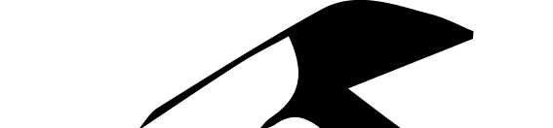
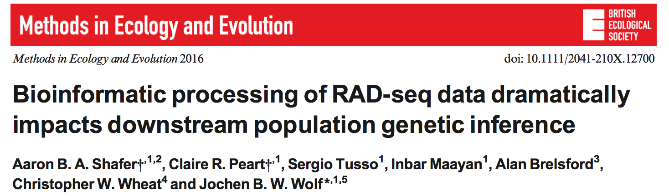
Shafer et al. 2016

Slide 10
Shafer et al. 2016
They observed large differences between reference-based and de novo approaches, the former generally calling more SNPs and reducing F_{IS} and T_{s}/T_{v}.
The site frequency spectrum was highly sensitive to the chosen approach and null expectations were best met by reference-based approaches, although contingent on the specific criteria.
Recommend that RADseq studies employ reference-based approaches to a closely related genome

Slide 11
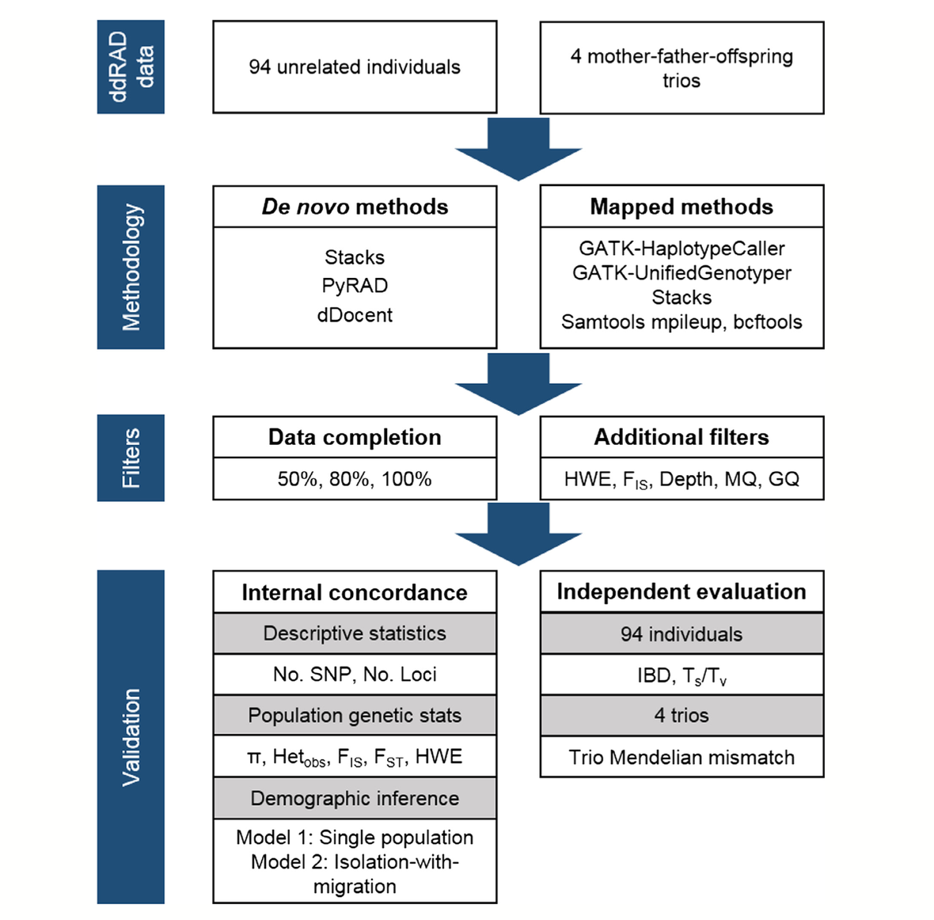
Shafer et al. 2016

Slide 12
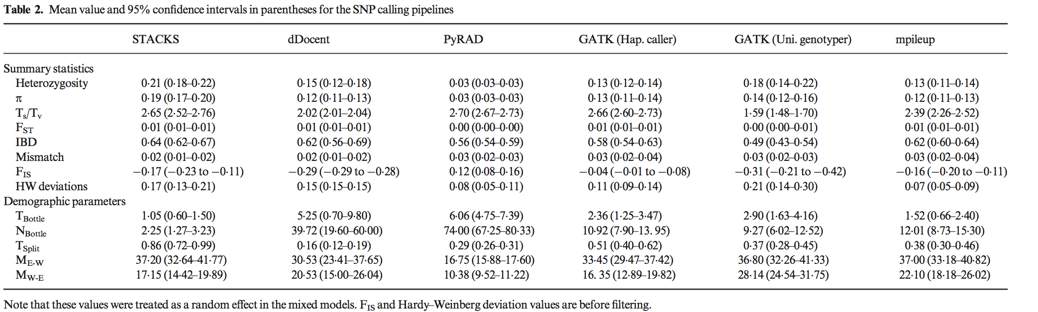
Shafer et al. 2016

Slide 13
Issues with Shafer et al. 2016
Filtering was not the same across all pipelines
De novo assemblies were not optimized
2 assembly iterations for STACKS
6 for pyRAD
1 for dDocent
Across de novo pipelines, filtering was NOT equivalent
The -m parameter in STACKS and the depth of cluster parameter for pyRAD would have lead to the de novo pipelines including SNPs with different minimum genotype depths.
3 or 8 for STACKS
3, 6, or 8 for pyRAD
dDocent, as configured, would have included SNPs with 1X coverage.
All pipelines should have had the same minimum depth parameter (5x) as the reference based pipelines.

Slide 14
Issues with Shafer et al. 2016
Trimmed reads should not be used as input for dDocent.
dDocent has an assembly module for merged reads that wasn’t used
dDocent also has a reference based approach that wasn’t used

Slide 15

Assemblin’ ain’t easy
RAD de novo assembly challenges:
Reads often do not overlap
Reads are often much shorter than genomic fragments
Sequencing errors, PCR errors
Data sets are large and diverse with multiple alleles per locus
Notes:
The figure on the right is a haplotype network from one simulated rad locus (80 individuals) to demonstrate the complexity of data. Imagine scaling this up to 20,000 loci.
There’s reason inbred lines are selected for genome assemblies!

Slide 16
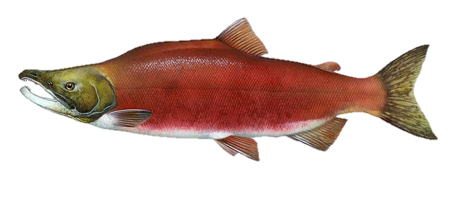
RAD de novo assembly artifacts
Over-clustering
Possible causes:
Paralogs
Polyploidy
Relatively easy to detect
High levels of coverage and heterozygosity
> 2 haplotypes per individual

Slide 17
RAD de novo assembly artifacts
Over-clustering
Small percentage of loci, even with liberal assembly parameters
Ilut et al. (2014)
Harvey et al. (2015)

Slide 18
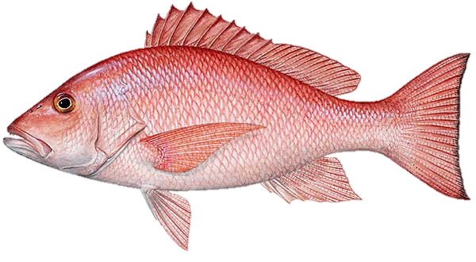
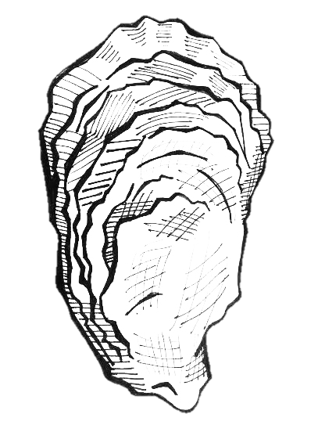
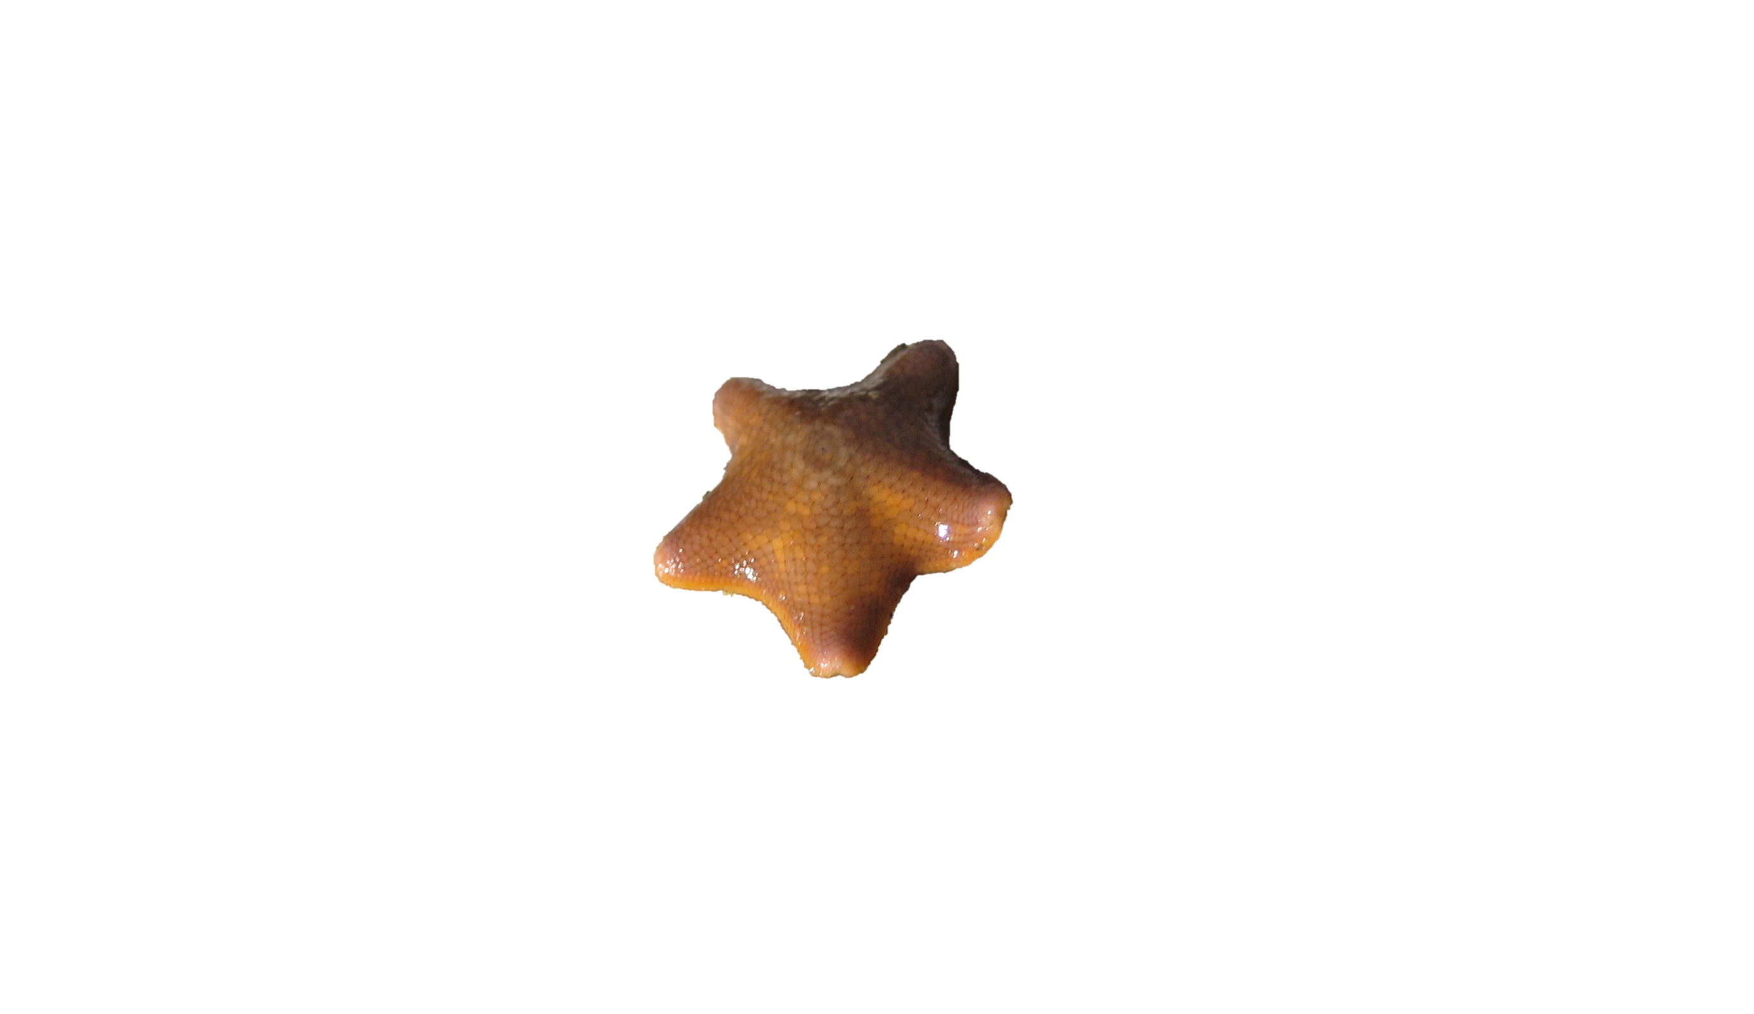
RAD de novo assembly artifacts
Over-splitting
Possible causes:
Divergent alleles
Ancestral polymorphisms
Introgression
INDELs
Difficult to detect
Appear to be homozygous loci

Slide 19


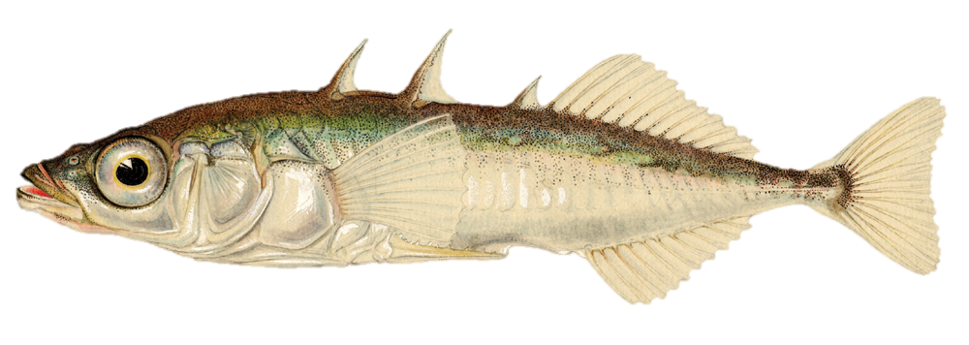
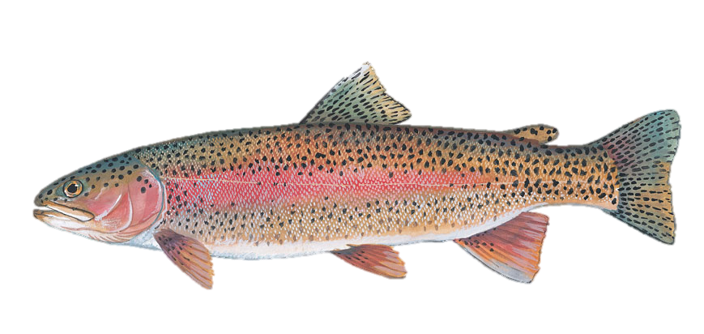
Toppling Stacks
Catchen et al. 2013. Molecular Ecology.
The default de novo assembly method cannot handle INDEL variation.
Reads with INDELs will not cluster

Slide 20
dDocent: RADseq Analysis Pipeline
Quality Filtering
De Novo Assembly
dDocent is a customizable BASH pipeline that follows the traditional NGS bioinformatic workflow
Specifically designed to handle high levels of polymorphism
Can handle INDEL polymorphisms
It uses a novel data reduction method to help with reference assembly
Read Mapping
SNP Calling
SNP Filtering

Slide 21
The effects of INDELs and over-splitting on population genetic inference from RAD sequencing
MIND THE GAP

Slide 22

Simulated RAD datasets
simrrls (version 1.5) by Deren Eaton https://github.com/dereneaton/simrrls
t=10
t=5
t=0
50
25
5
Two different levels of polymorphism: ⍬ = 0.005 and ⍬ = 0.001
Three different probabilities of INDEL polymorphism: 0.01, 0.05. 0.1

Slide 23

Simulated RAD datasets
simrrls (version 1.5) by Deren Eaton https://github.com/dereneaton/simrrls
t=10
t=5
t=0
150
100
50
Added a third level of polymorphism: ⍬ = 0.003

Slide 24

Assembly of 1000 simulated ddRAD loci
dDocent
pyRAD
aftrRAD
Stacks
PE
SE
PE
SE
Gapped
Default
1% INDELs
5% INDELs
10% INDELs
Notes:
Assembly parameters were varied for 7 different versions of RADseq pipelines:
dDocent 2.19 - Paired-end and Single-end
pyRAD 3.0.66- Paired-end and Single-end
aftrRAD 5.0
Stacked v1.40 Using the default ungapped assembly method and new gapped assembly method
Note how the scales on each graph change.

Slide 25

Assembly of 1000 simulated ddRAD loci
dDocent
pyRAD
aftrRAD
Stacks
PE
SE
PE
SE
Gapped
Default
1% INDELs
5% INDELs
10% INDELs
Notes:
The pattern is similar if using a 5% cutoff. Past 1% INDELs Stacks

Slide 26

Results
How sensitive are various RADseq pipelines to over-splitting?
dDocent-PE provides the most accurate de novo assemblies
dDocent-SE and both pyRAD are moderately sensitive to INDELs
Both versions of Stacks are highly sensitive to INDELs

Slide 27

Key differences in RAD assembly strategies
Stacks (Catchen et al. 2013), pyRAD (Eaton et al. 2014)
Cluster reads within individuals into loci
Call SNPs in loci within individuals
Cluster loci across individuals
dDocent (Puritz et al. 2014)
Remove reads below a within individual coverage level
Remove reads below an among individual coverage level
Cluster reads by aligned sequence similarity*
aftrRAD (Sovic et al. 2015)
Remove reads below a coverage cutoff
Match allelic pairs of reads
Merge allelic pairs that share a read into loci

Slide 28

For assembly, less is more
Simulated RAD locus
4,776 reads
225 unique sequences

Slide 29


Sequences with > 1X coverage
Simulated RAD locus
4,588 reads
35 unique sequences

Slide 30

Sequences with >1X coverage, >1 individual
Simulated RAD locus
4,487 reads
12 unique sequences

Slide 31

Sequences with >1X coverage, >3 individuals
Simulated RAD locus
4,059 reads
6 unique sequences

Slide 32
Results
How sensitive are various RADseq pipelines to over-splitting?
dDocent-PE provides the most accurate de novo assemblies
dDocent-SE and both pyRAD are moderately sensitive to INDELs
Both versions of Stacks are highly sensitive to INDELs
What are the effects of over-split loci on estimates of population genetic structure?

Slide 33
Effects of over-splitting on heterozygosity and F_{ST}
dDocent-R
Stacks-R
Notes:
Because I used non-equilibrium simulations, it’s difficult to predict exact values for popgen parameters. To infer estimates from RADseq data that is unbiased from reference assembly, I created a perfect reference with one read per locus and then mapped reads to the reference. These alignments were then passed to dDocent and Stacks. These will be used as our expected values.

Slide 34
Effects of over-splitting on heterozygosity and F_{ST}
dDocent-R
Stacks-R
⍬ = 0.003, INDELs = 5%

Slide 35
Effects of over-splitting on heterozygosity and F_{ST}
dDocent-R
Stacks-R
dDocent
pyRAD
⍬ = 0.003, INDELs = 5%
Notes:
Notice how pyRAD and dDocent largely capture the same pattern as our reference data sets

Slide 36
Effects of over-splitting on heterozygosity and F_{ST}
dDocent-R
Stacks-R
dDocent
Stacks-G
pyRAD
Stacks
⍬ = 0.003, INDELs = 5%
Notes:
Notice the the truncation of Heterozygosities observed in both Stacks versions. AftrRAD is extremely similar but not pictured.

Slide 37
Results
How sensitive are various RADseq pipelines to over-splitting?
dDocent-PE provides the most accurate de novo assemblies
dDocent-SE and both pyRAD are moderately sensitive to INDELs
Both versions of Stacks are highly sensitive to INDELs
What are the effects of over-split loci on estimates of population genetic structure?
Over-splitting loci negatively biases estimates of observed heterozygosity

Slide 38

RAD de novo assembly artifacts
Over-splitting

Slide 39
Percent error of F_{ST} across all simulations
Notes:
Across all pipelines, as expected FST decreases, the accuracy of FST estimates increases. However, pipelines subjected to overspitting (Stacks, Stacks-G, and aftrRAD) fair much worse.

Slide 40
RAD de novo assembly artifacts
Over-splitting
Actual
Estimated
Notes:
You can imagine this happens when alleles are only partially split (i.e. only one rare allele is removed from heterozygous genotypes). This leads to an artificial increase in the allele that is left as it is inferred to be a homozygote

Slide 41
Effects of over-splitting on minor allele frequency

Slide 42
Results
How sensitive are various RADseq pipelines to over-splitting?
dDocent-PE provides the most accurate de novo assemblies
dDocent-SE and both pyRAD are moderately sensitive to INDELs
Both versions of Stacks are highly sensitive to INDELs
What are the effects of over-split loci on estimates of population genetic structure?
Over-splitting loci negatively biases estimates of observed heterozygosity
Over-splitting loci introduces error into estimates of F_{ST}, especially at lower levels of population structure

Slide 43

Implications
De novo RAD assemblies need to be properly optimized!
Previous published results from assemblies without alignment need to be interpreted with caution
Especially in higher gene flow species
IN =
OUT
You should check out the dDocent pipeline!
https://github.com/jpuritz/dDocent
Notes:
That’s not icecream!

Slide 44
Discussion? Questions?

Slide 45
Exercises
bash /gdc_home2/groups/BAG18/1_monday/Install.sh
Ref.Ex, Map.Ex, Filter.Ex, EecSeq.Ex
Markdown Format exercises can be found at https://github.com/jpuritz/Winter.School2018

Slide 46
Exercises
bash /gdc_home2/groups/BAG18/1_monday/Install.sh
Ref.Ex, Map.Ex, Filter.Ex, EecSeq.Ex
Markdown Format exercises can be found at https://github.com/jpuritz/WinterSchool.2018
Thank you to ETH and B@G for inviting me back!
Thanks to all of you for your attention!
Find me online!
jpuritz@gmail.com
https://www.researchgate.net/profile/Jonathan_Puritz
Twitter: @jonpuritz
Instagram: @jonpuritz
Website: MarineEvoEco.com

